Slide 1
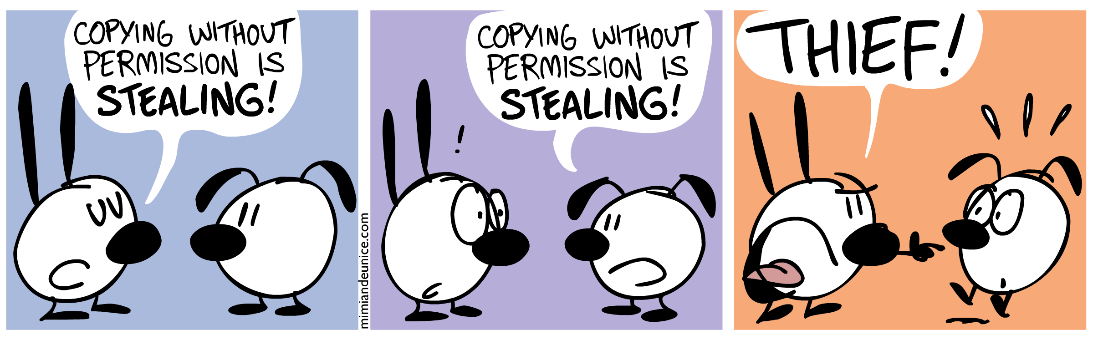
Why do I need to cite my sources?
Paley, Nina. “Thief.” Mimi and Eunice, 30 July 2010, mimiandeunice.com/?s=copying+without+permission&submit.x=0&submit.y=0.

Slide 2
Why should you cite?
To show your reader you've done proper research by listing sources you used to get your information
To be a responsible scholar by giving credit to other researchers and acknowledging their ideas
To avoid plagiarism by quoting words and ideas used by other authors
To allow your reader to track down the sources you used by citing them accurately in your paper by way of footnotes, a bibliography or reference list
(“Citing Sources”)

Slide 3
When should you cite?
“You are expected to reference every time you use someone else’s work or ideas in your own work.”(Pears 1)

Slide 4
What should you cite?
All sources that you use in your work should be cited.
That includes any information:
Copy & pasted
Repeated word-for-word
Paraphrased
Summarized

Slide 5
Anything I shouldn’t cite?
Anything that is common knowledge
How do you know if something is common knowledge, to YOU?
Ask yourself:
Did I know this information before I started this assignment?
Did this information/idea come from my own brain?
If NO...not common knowledge to YOU...so CITE IT!!

Slide 6
How should you cite?
Use MLA8 style to format your citations
There are two parts to this process:
In-text citations --- used in the body of your work, showing where you have used another’s ideas
Work cited list (NOT Bibliography) --- created at the end of your work, this is an alphabetical list of all the sources you used in your work.

Slide 7
In-Text Citations
In-Text citations are placed in parentheses, and have two components:
The first word found in the full citation on the Works Cited page (usually the last name of the author) OR SHORT TITLE if no author
The location of the direct quote or paraphrase (usually a page number)
In-Text citations should be placed directly after the direct quote or paraphrase, or in a place that is a natural pause and does not cause the reader to become distracted while reading the body of your work
These link to the Works Cited list at the end of your work, which are arranged in alphabetical order by author

Slide 8
In-Text Citations Examples
Direct Quote:
Evans & Jenkins state that “there was indignation and outrage as Chancellor Scheidmann denounced the terms in the Reichstag” (23)
Paraphrase:
Lloyd George wanted Treaty terms to be more lenient, whereas Clemenceau was demanding harsher terms (Evans 23)

Slide 9
Works Cited Reference
Evans, David and Jane Jenkins. “The Treaty of Versailles.” Years of Weimar & the Third Reich. Hodder & Stoughton, 1999, pp. 20-26.
How to create a hanging indent:
https://www.youtube.com/watch?v=n7rtKPYfhk0

Slide 10
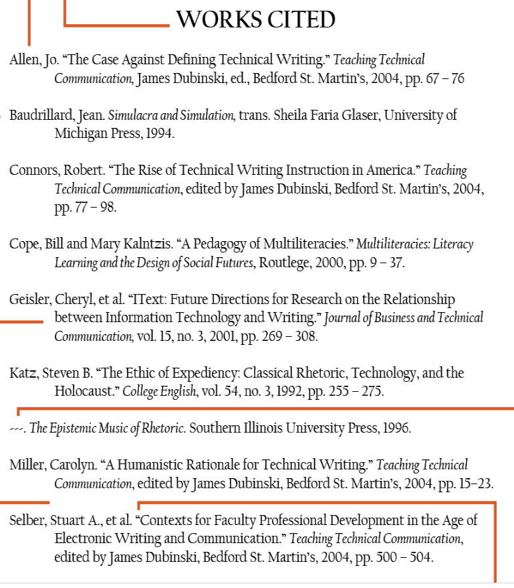
Example Works Cited Page

Slide 11
Citing Different Types of Sources
Different types of sources often have slightly different requirements for citation
You DON’T need to learn them off-by-heart...
Just know where to check the style, like here:
http://www.easybib.com/guides/citation-guides/mla-8/

Slide 12
Beware Citation Machines
Sites like Zotero, Easybib & Bibme are great...they seem to do your work for you
BUT...
Automatically generated citations are NOT always accurate so you MUST check them

Slide 13
Works Cited
“Citing Sources: Overview.” LibGuides, libguides.mit.edu/c.php?g=176032&p=1159439#18 85808. CC BY-NC 2.0
“In Text Citations in MLA 8.” EasyBib, Imagine Easy Solutions, http://www.easybib.com/guides/citation- guides/mla-8/in-text-citations/.
Pears, Richard, and Graham Shields. Cite Them Right: The Essential Referencing Guide. 10th ed., Palgrave, 2016.

